Slide 1
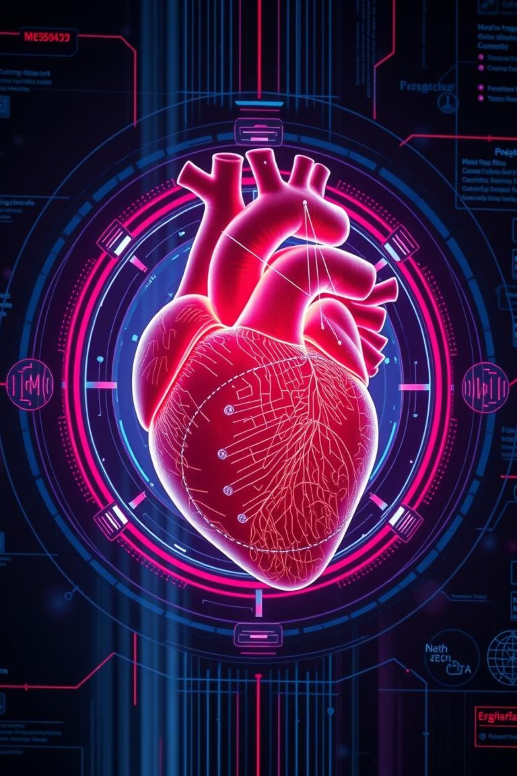
Heart Disease Prediction System Using Machine Learning
Vadaparthi Lakshminarayana

Slide 2
Project overview
This project utilizes machine learning algorithms to analyze health-related data (such as age, blood pressure, cholesterol level, etc.) to predict the risk of heart disease. The system aims to assist medical professionals and patients in early diagnosis, allowing timely medical intervention.
It uses historical data from patients to train a predictive model and outputs a binary classification whether they have the heart disease or not.
The main objective is to develop a predictive system that can accurately detect the likelihood of a person having heart disease through machine learning techniques.

Slide 3
Tools & Technologies Used
Language: Python
Libraries: scikit-learn, pandas, numpy, matplotlib, seaborn
ML Algorithms: Logistic Regression, Random Forest, KNN, SVM
Model Evaluation: Accuracy, F1-Score, Confusion Matrix
Deployment (optional): Streamlit app

Slide 4
Dataset and Preprocessing
The dataset used in this project was obtained from kaggle, a popular platform for data science and machine learning datasets. It contains anonymized patient data relevant to heart disease diagnosis. This dataset is widely used for classification problems in health analytics and contains various medical attributes that help predict the presence of heart disease.
Key challenges encountered included overfitting, data imbalance, and feature redundancy. These were effectively tackled through advanced feature selection algorithms, rigorous cross-validation techniques, and data cleaning. The project underscored the critical importance of large, high-quality datasets and standardized evaluation metrics for robust predictive models. In the data preprocessing cleaning of the data and removing the noise takes place.
After preprocessing all data was converted to a clean, numerical format. Features were normalized to the same scale. Dataset was ready for input into multiple machine learning models.

Slide 5




Conclusion and Future Work
High Potential
ML models offer significant promise for early heart disease prediction.
Multi-Modal Data Integration
Future efforts will include imaging and genetics for comprehensive insights.
Real-Time Monitoring
Developing capabilities for continuous patient data analysis.
Continuous Improvement
Leveraging larger, diverse datasets for model refinement.

Slide 6
Thank you

